Slide 1
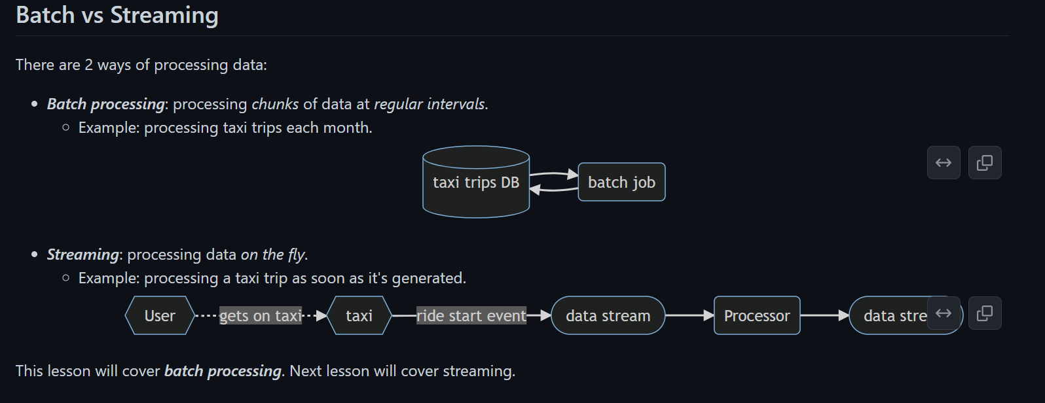

Slide 2
Types of batch jobs
A batch job is a job (a unit of work) that will process data in batches.
Batch jobs may be scheduled in many ways:
Weekly
Daily (very common)
Hourly (very common)
X times per hours
Every 5 minutes
Etc...
Batch jobs may also be carried out using different technologies:
Python scripts (like the data pipelines in lesson 1).
Python scripts can be run anywhere (Kubernets, AWS Batch, ...)
SQL (like the dbt models in lesson 4).
Spark (what we will use for this lesson)
Flink
Etc...

Slide 3
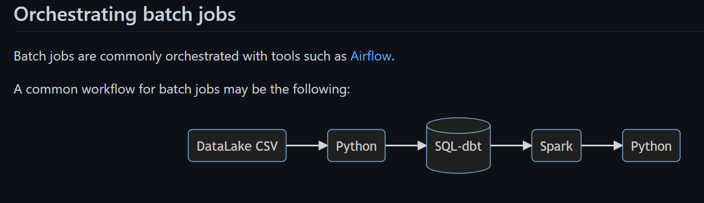

Slide 4
Pros and cons of batch jobs
Advantages:
Easy to manage. There are multiple tools to manage them (the technologies we already mentioned)
Re-executable. Jobs can be easily retried if they fail.
Scalable. Scripts can be executed in more capable machines; Spark can be run in bigger clusters, etc.
Disadvantages:
Delay. Each task of the workflow in the previous section may take a few minutes; assuming the whole workflow takes 20 minutes, we would need to wait those 20 minutes until the data is ready for work.
However, the advantages of batch jobs often compensate for its shortcomings, and as a result most companies that deal with data tend to work with batch jobs mos of the time (probably 90%).

